Slide 1

Capstone Project: Calorie Prediction from Food Images
Using Machine Learning Techniques
Alexandre Dolgopolov
September 2024

Slide 2
Introduction
The problem was inspired by the dataset "Nutrition 5k" and a similar exercise described in the paper was conducted.
Goal: Predict normalized kcal and macronutrients (i.e. kcal and macronutrients per 100 gram of food) – we will call them “outputs”.
Data: every 5th frame from camera_A and camera_D only (view from above) – the most representative of how people make pictures of the dish.

Slide 3
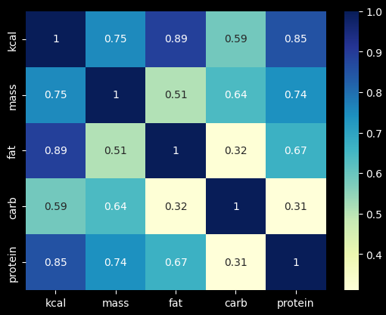
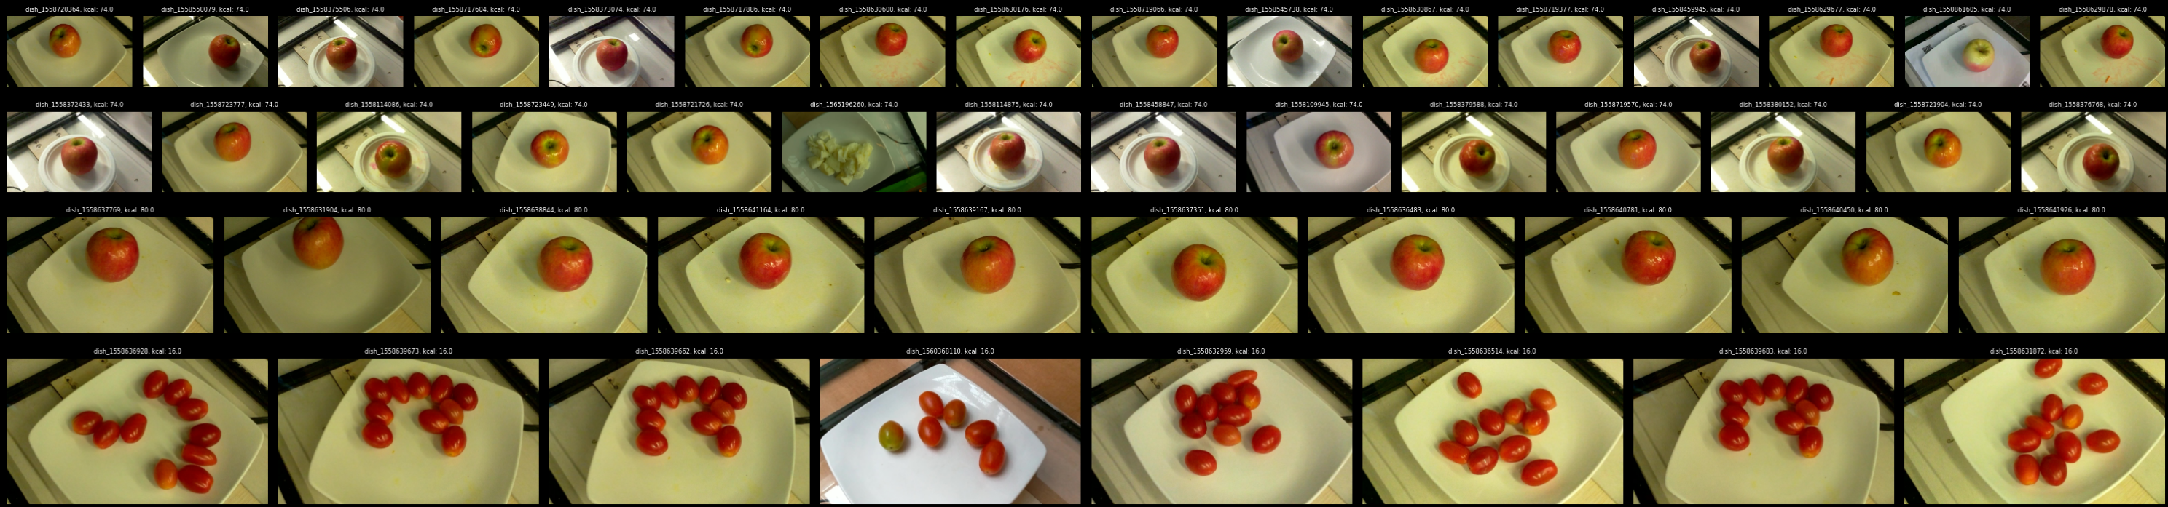
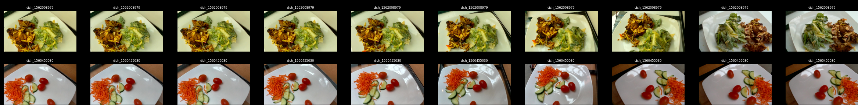
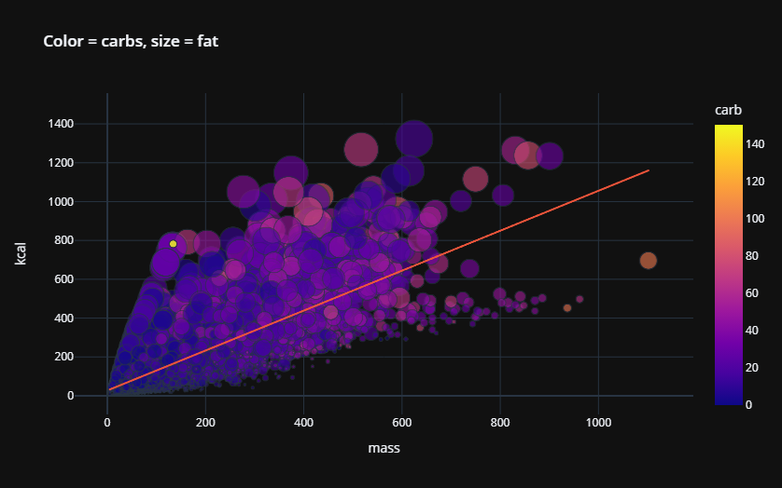
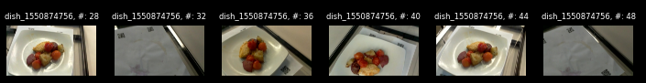
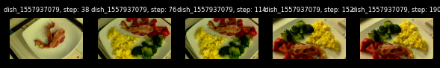
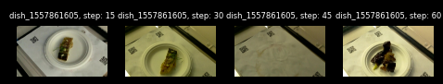
EDA - observations
Significant correlation of outputs observed – justifies the use of multi-task model with shared layers for better learning.
Data contains a lot of similar dishes – especially small ones – apples, tomatoes, other ingredients or simple meals composed of one ingredient.
Low image diversity.
Frames above 30 might result in incorrect information.
Outliers (discared from the data > 2000kcal and < 2000grams).

Slide 4
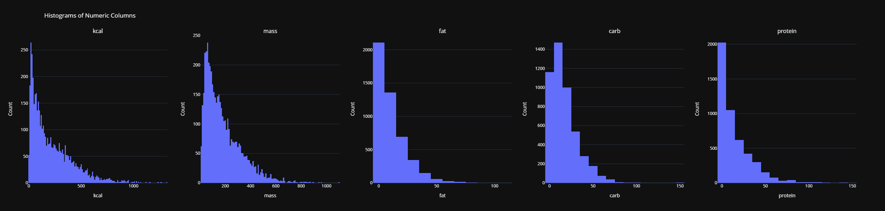
EDA
Observations:
Imbalanced dataset – significant amount of small dishes (composed of one simple ingredient)

Slide 5

Machine learning
Baseline: average of every output calculated on the training data.
Random Forest model.
Linear regression model (Ridge Regression).
Main model (inspired by Google paper) – multi-task deep neural network.

Slide 6
Model evaluation
Main model:
Loss: MAE function. Validation: MAE.
Random Forest:
Loss: default (mean squared errors). Validation: MAE.
Ridge Regression:
Loss: default (mean squared errors). Validation: MAE.
Analysis of each model performance:
Residuals vs Fitted
Fitted vs Actual.
Residuals distribution vs baseline residuals distribution.
Main model: additional visual inspection of dishes with large errors.
Model comparison:
Residuals distribution accros all four outputs.
MAE for all four outputs.
R2 for all four outputs.

Slide 7
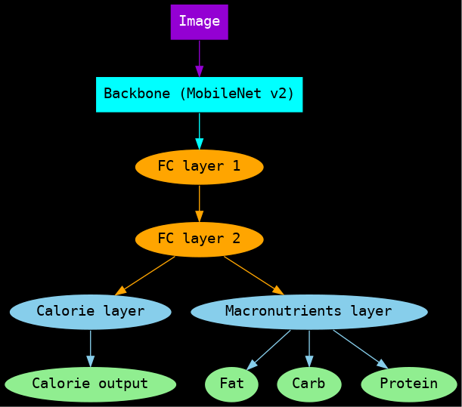
Main Model
Input layer: includes data augmentation as explained above.
Backbone: MobileNet V2.
GlobalAveragePooling2D instead of Average Pooling in order to limit the number of parameters to make the training less computationally intensive. Also, as we are not interested in predicting portion size, there is no need in Average Pooling.
Two fully connected layers like described in the paper.
Specific fully connected layer for each task like described in the paper.
Two task model - one for kcal, one for other macros - carbs, fat and protein. This is a regression problem.
The loss function will include weighting as follows:
Loss = 1.0 x loss kcal + 1.0 x loss macro
where loss macro = average loss of carbs, protein, fat
For model training, additional preprocessing of data will be used to speed up the training (see below).
The training will be conducted on A100 GPU.
Mixed precision training will be used due to memory constraints.
batch_size = 42 and image per dish = 1, to ensure the model sees different images per epoch.
buffer_size = 1000 for shuffling - meaning pre-load 1000 elements of the data and shuffle it before distributed to batches. It shuffles parts of the dataset dynamically during the data loading process, specifically within the buffer. This is to ensure that as batches are created, the dishes are randomly drawn to avoid any pattern in batch composition across epochs.
The dataset is also shuffled at the beginning, to ensure that the entire dataset starts in a random order before batching begins.
initial learning rate of 1e-4 with RMSprop optimizer as per Google paper. However, as the batch_size used by Google is unknown, additionally ReduceLROnPlateau is introduced with restating of initial learning rate every time the model improves, to ensure better loss exploration.
Optimizer: RMSprop for faster convergence with standard parameters.
early stopping after 22 epochs.

Slide 8
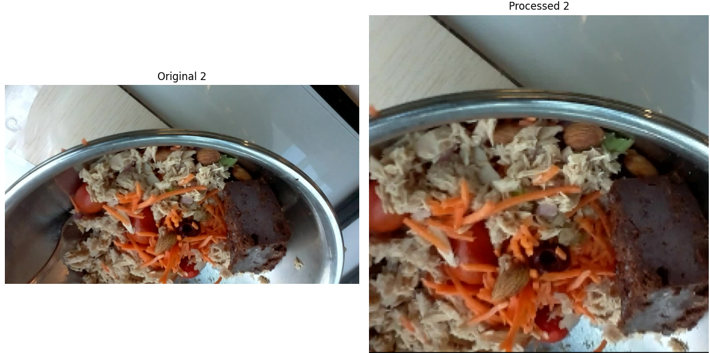
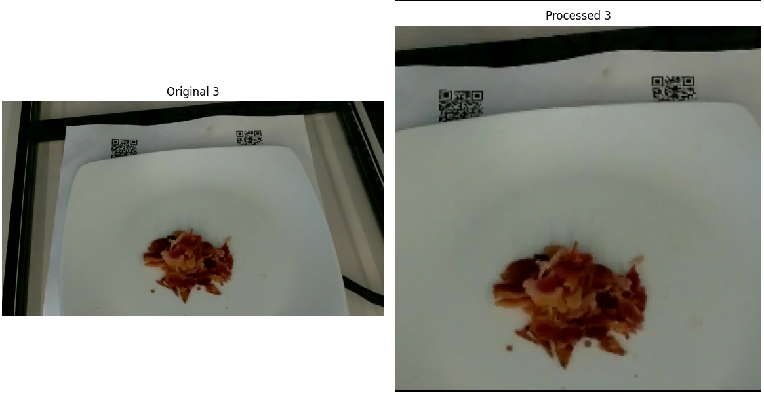
Data pre-processing
Each batch will contain a randomly selected set of 42 unique dishes.
For each dish 1 random image is chosen.
Within a batch, each dish and image are unique, but across batches, the same dishes and images can appear again due to the random shuffling and sampling process.
Image paths for each dish will be saved to pkl files for both training and testing sets to speed up training.
One of the crucial steps is to apply correct cropping of images, as they are not perfect and sometimes the plate and surroundings take significant part of the frame, as well as the food can be small and close to the edges of the frame.
The images are first scaled with the scaling factor, calculated to ensure the smallest dimension (either height or width) is scaled to 224 while maintaining the aspect ratio. The center region is then cropped with 224x224 dimension.
For Random Forest and Ridge Regression, the features will be extracted from the images that were processed with center cropping described above.

Slide 9
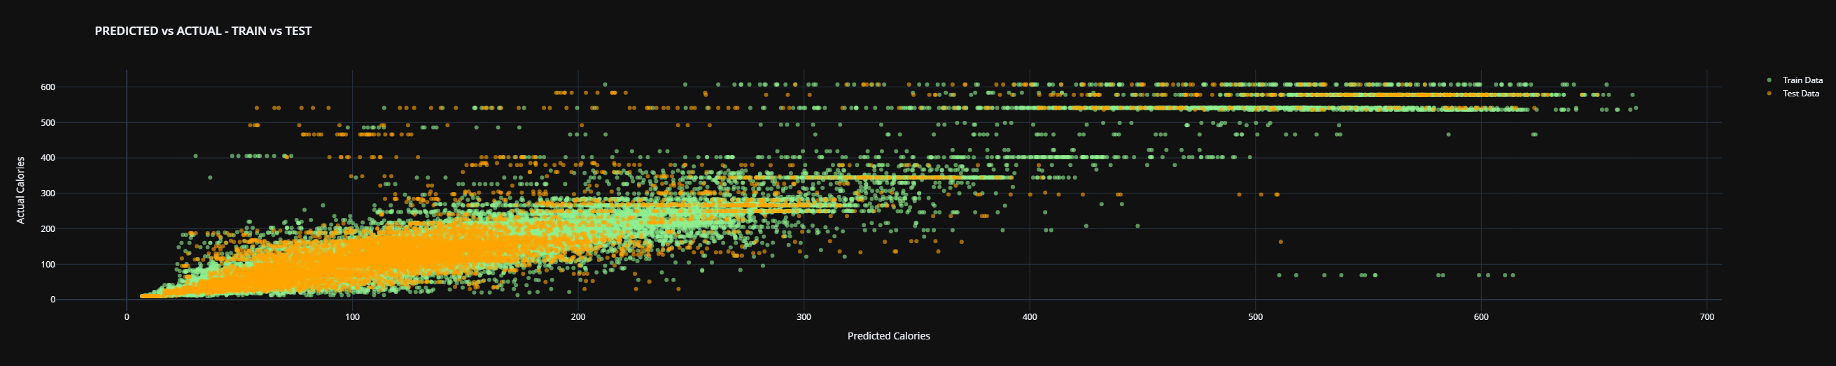
Main Model - Results
The larger spread and deviations from the diagonal line in the test data suggest that the model might be overfitting the training data, as it performs worse on the test set.
High variability in predictions for higher actual calorie values indicates that the model struggles more with accurately predicting higher calorie values. This might be due to imbalanced dataset as we have seen during EDA.

Slide 10
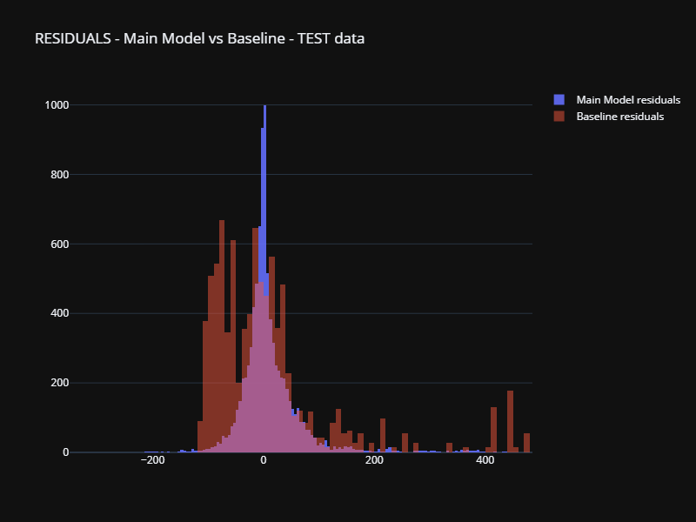
Main Model - Results
The model significantly outperforms baseline, suggesting the model learns from data.
Residuals are centered around zero which is desirable.
There are a few large residuals that need to be investigated.

Slide 11
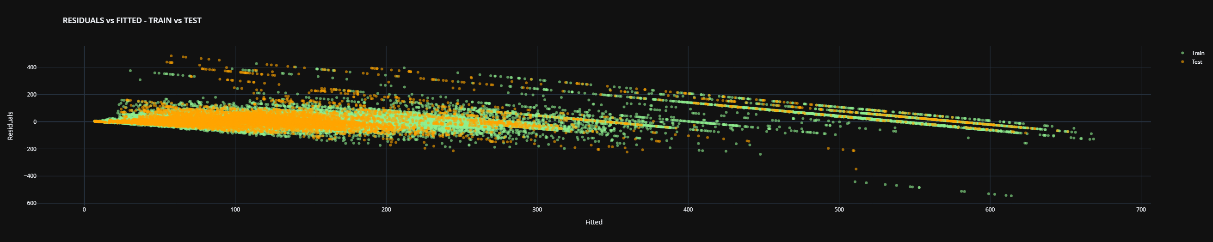
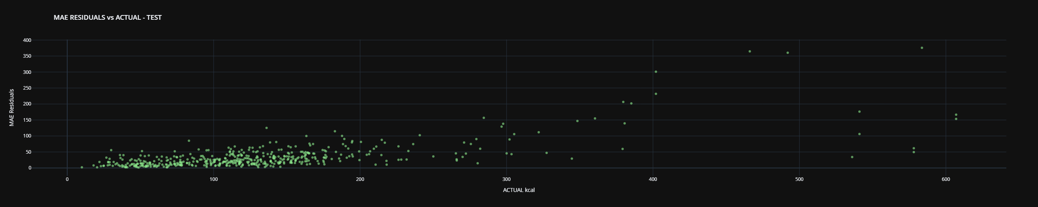
Main Model - Results
Both the train and test residuals follow a similar pattern, which suggests that the model is consistent in its predictions for both datasets.
For lower fitted values, more residuals are positive, indicating underestimation. For higher fitted values, more residuals are negative, indicating overestimation.
The spread of residuals is larger for the test data compared to the train data. This suggests that the model may be overfitting to the training data and does not generalize as well to unseen data.
Larger spread in the test residuals indicates higher variability and less reliable predictions on new data.
Straight diagonal lines indicate a pattern of significant variance in prediction of the same dish - will be further demonstrated below
Clearly higher dishes in kcal result in much higher errors.
There are also fewer observations for high kcal dishes.

Slide 12
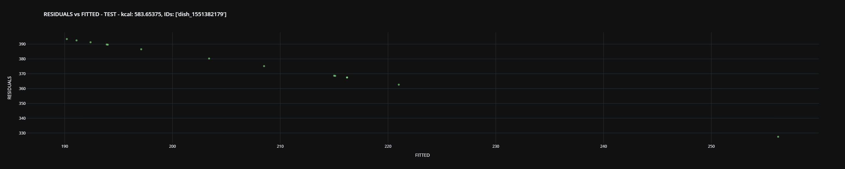
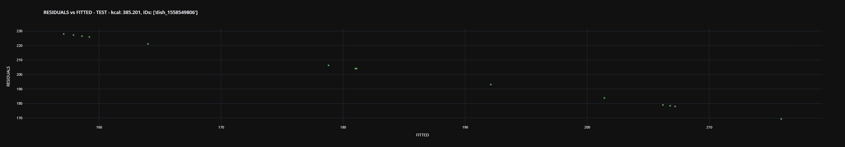
Main Model - Rotation
Small rotation for a single dish may result in significative difference in prediction.

Slide 13
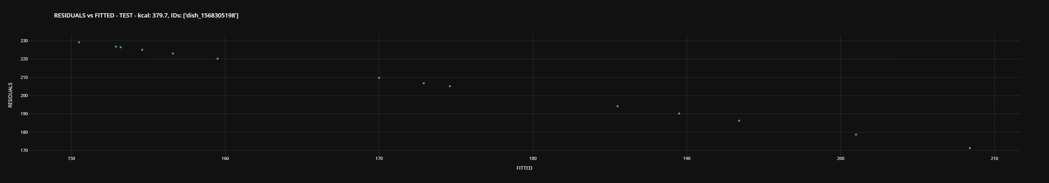
Main Model – Lightning and plate color
Plate color and lightning condition result in significant difference in prediction.

Slide 14
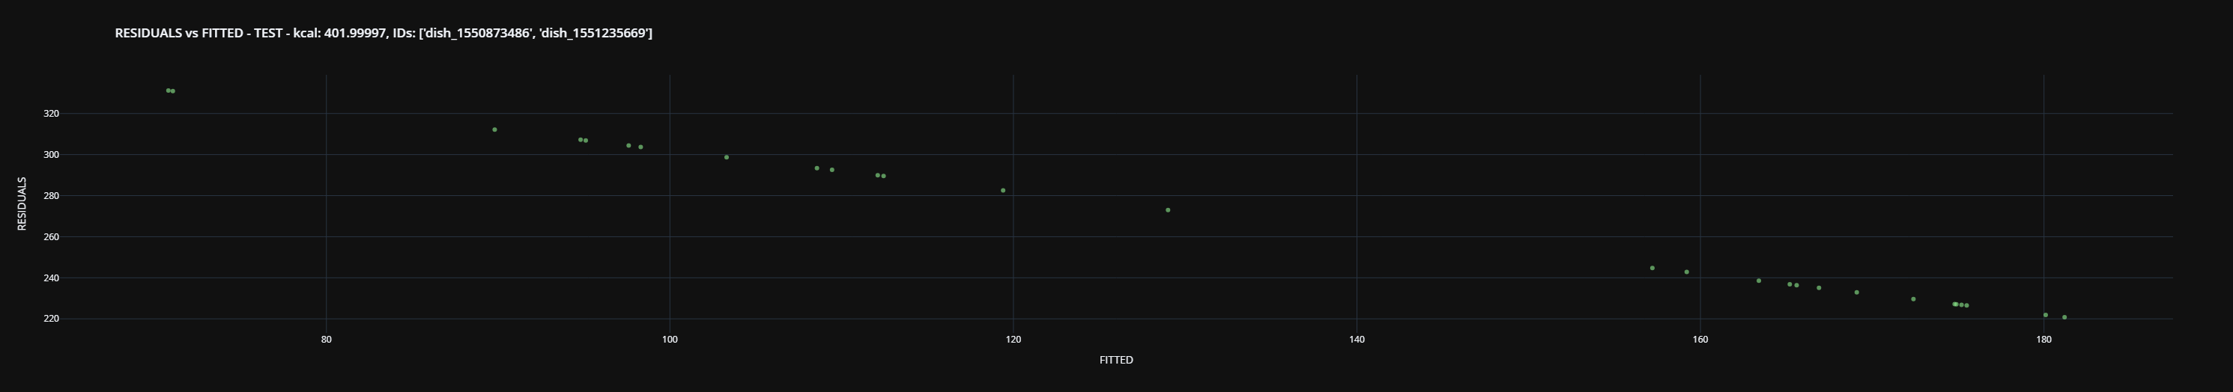
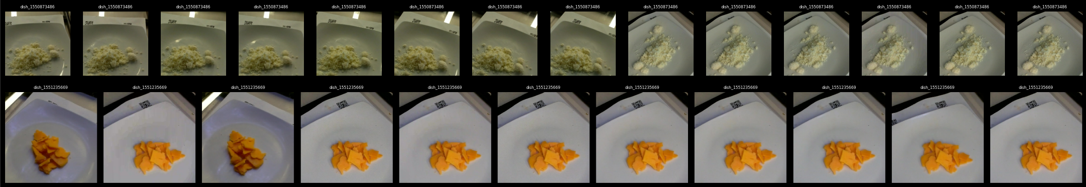
Main Model – variation of dishes for same kcal
Significant variation of dishes for exactly the same kcal.

Slide 15
Main Model – Conclusion
Inconsistencies in prediction and overfitting still observed - despite increase in regularization and random rotation.
Small rotation for a single dish may result in significative difference in prediction.
Different lightning conditions may result in significant difference in prediction.
Clearly higher dishes in kcal result in much higher errors as well as significant difference in predictions for the same dish depending on rotation and lightning conditions.
There are also fewer observations for high kcal dishes.
We observe significant variation in residuals for the same amount of kcal. For smaller values the model tend to over estimate kcal while for larger values if significantly underestimates the amount. Both patterns observed in train and test.
Additional issues with data identified:
Inconsistency in luminosity resulting in significantly different plate color for the same dish.
Significant variation of dishes for exactly the same kcal.
What we learn:
Without mass and density estimation it is difficult for the model to learn to predict kcal of high caloric dishes even if the data is normalized by mass.
Without mass and density estimation the model is highly volatile in predictions especially for high caloric dishes.
Calorie prediction remains very approximative and is not reliable for serious regimes.

Slide 16
Random Forest
Extract features with MobileNetV2.
RandomSearchCV with 3 folds cross-validation to find optimal parameters. Mean squared error is minimized and averaged across 4 outputs, while scoring is negative mean absolute error.
Model prioritizes kcal as the loss of kcal and MAE is much larger than for fat, protein and carbs - which is fine for us as we are mainly interested in predicting kcal.
As the random forest is computationally intensive and not really possible to accelerate with GPU (unlike neural networks), we proceed in the following way:
first, we tune the best max_depth keeping other parameters constant.
second, we tune the best n_estimators using the best max_depth.
finally, we tune the best remaining parameters - min_samples_split and min_samples_leaf.

Slide 17
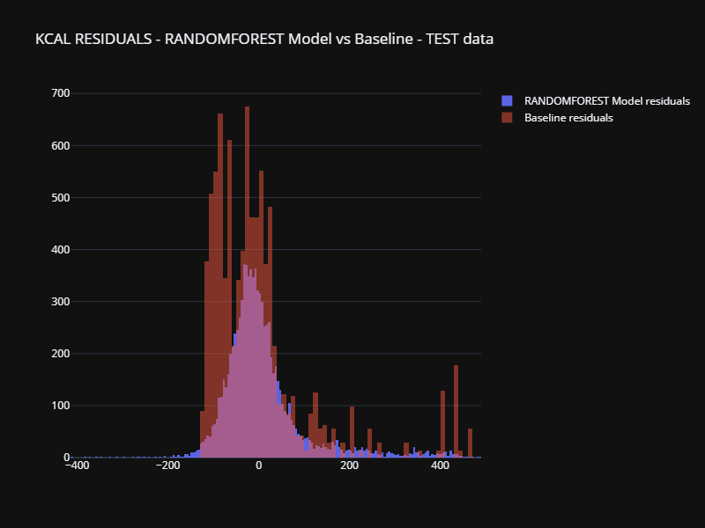
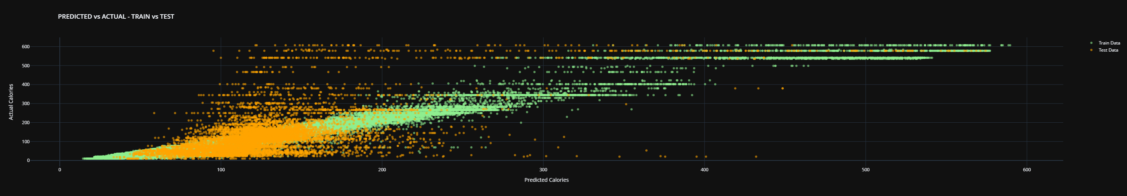
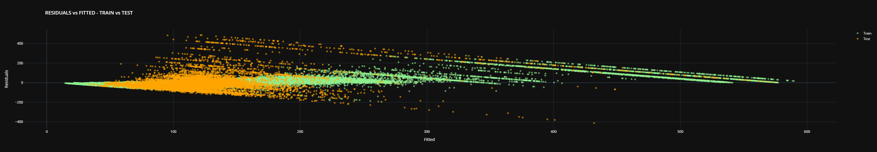
Random forest - Results
Still better than the baseline, the model learned some features however the errors are very high.
Variation for the same dish is much higher than the one of Main Model.
The difference between train and test is much higher and can be seen even for low kcal dishes, while for high kcal dishes it is completely wrong for the test set.
Very significant overfitting with very high test residuals compared to train results.

Slide 18
Linear regression model (Ridge Regression)
Extract features with MobileNetV2 (please see "Data preprocessing below").
Features will be scaled with StandardScaler.
RandomizedSearchCV with 3 folds cross-validation to find optimal parameters (regularization alpha). The loss function is default (Mean squared error) which by default is averaged accross 4 outputs, while scoring is negative mean absolute error.
Model prioritizes kcal as the loss of kcal and MAE is much larger than for fat, protein and carbs - which is fine for us as we are mainly interested in predicting kcal.

Slide 19
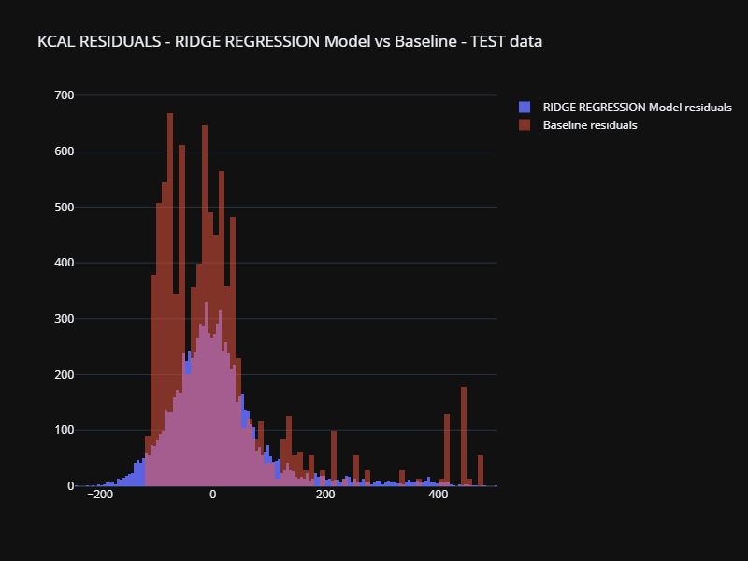
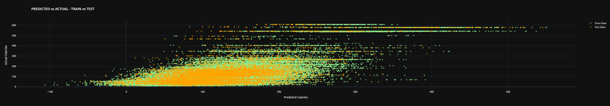
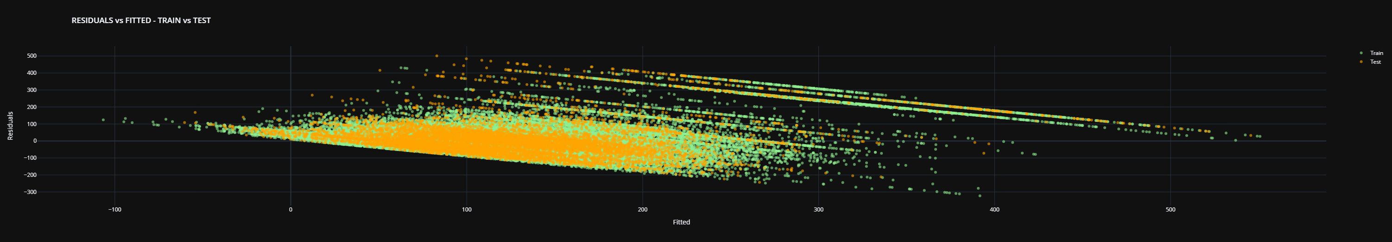
Ridge regression - Results
Still better than the baseline, the model learned some features however the errors are very high.
We notice significant dispersion per dish, clearly the model most probably fails to capture correctly the same dish resulting in significant variations.
The difference between train and test is high and can be seen even for low kcal dishes, while for high kcal dishes it is completely wrong for the test set.
Very significant overfitting with very high test residuals compared to train results.

Slide 20
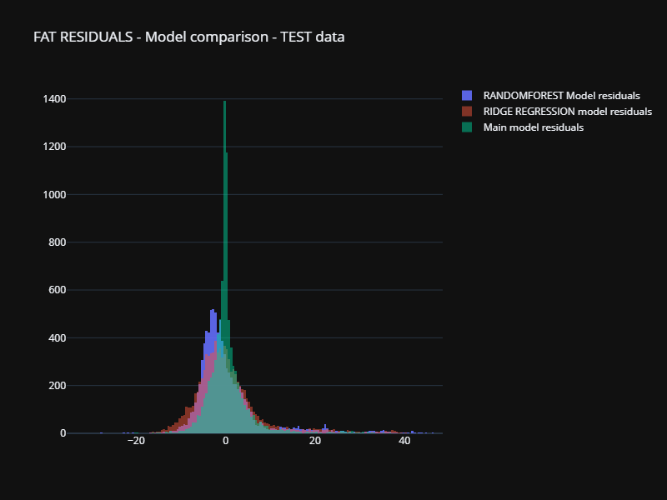
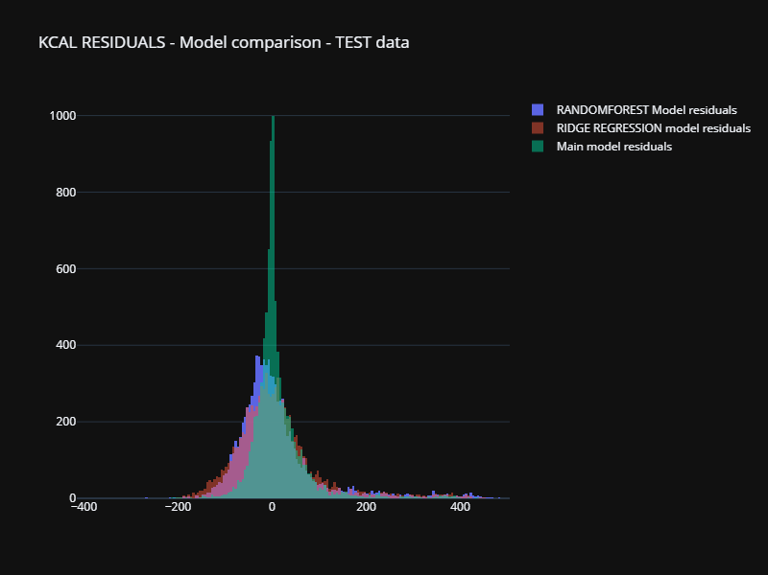
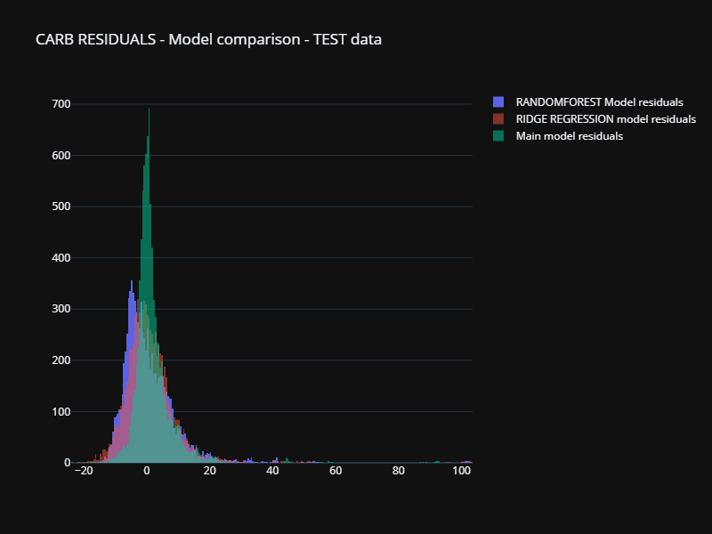
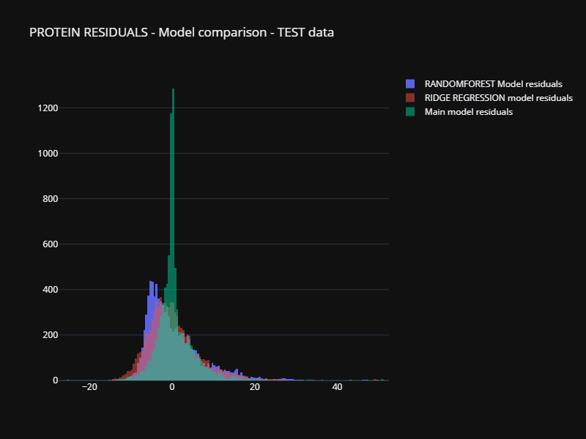
Model comparison: residuals distribution
Main model clearly outperforms Random Forest and Ridge Regression in terms of consistency and accuracy.
It is not obvious to see if Random Forest or Ridge Regression is better.
Right skewed shape for all models - suggesting more errors underestimating dishes than overestimating. We know where it is coming from - large kcal dishes and not enough data of such dishes.

Slide 21
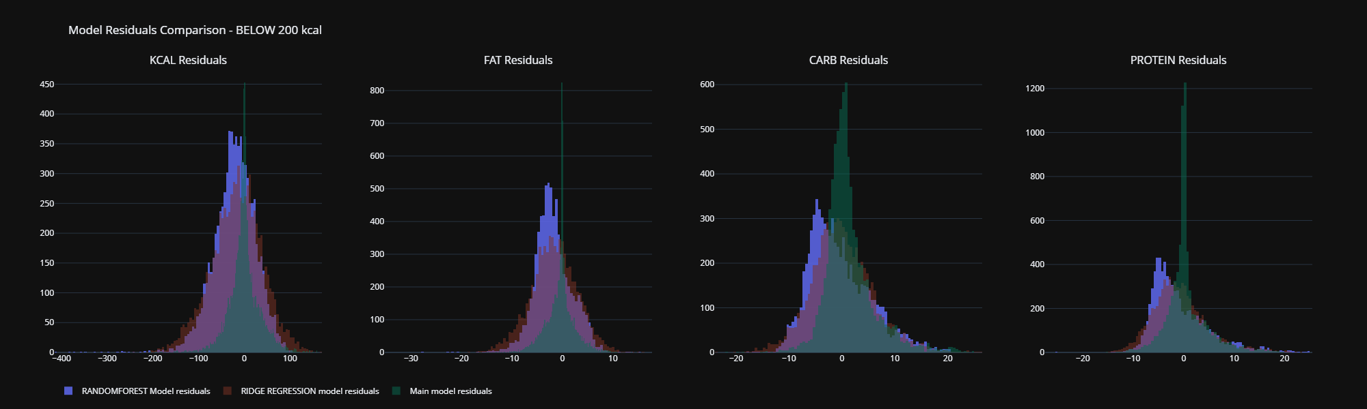
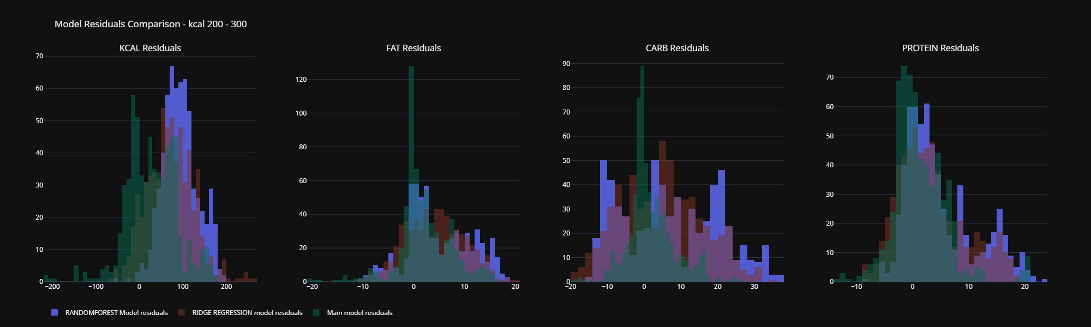
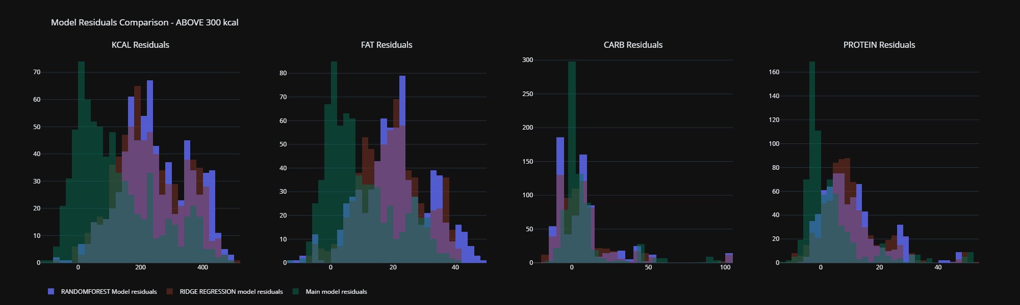
Model comparison: residuals distribution
Main model clearly outperforms Ridge Regression and Random Forest.
All models underestimate kcal, fat, carb and protein for dishes above 200 kcal, suggesting the data needs improvement - more high kcal complex dishes needed.

Slide 22
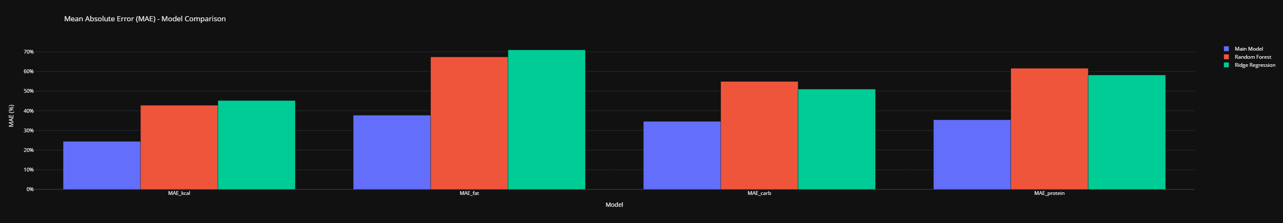
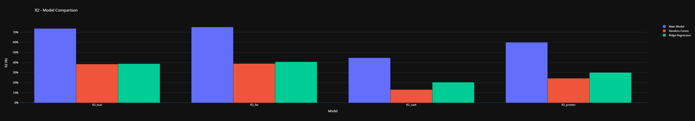
Model comparison: MAE and R2
Main model clearly outperforms Ridge Regression and Random Forest.
It is not obvious to see if Random Forest or Ridge Regression is better.
R2 and MAE indicate a somewhat acceptable results for the main model (depending on the context of usability – i.e. aproximate estimation of kcal from image of food).

